Slide 1
Personal Exemptions
Pub 17 – Chapter 3
Pub 4012 – Tab C
(1040-lines 6a & 42)
NJ 1040
Notes:
1

Slide 2
Exemption
Defined: Specific amount of money you are allowed to deduct from your taxable income, based on circumstances of your filing situation
Two types of Exemptions:
Personal Exemption
Dependent Exemption (to be covered in later section)
Enter all exemption-related data in TaxSlayer Basic Information section
Data is carried to Federal 1040 Page 1 and NJ 1040 Page 2

Slide 3
Summary of Personal Exemptions Types
Exemption Type | Federal Exemption | NJ Exemption
Personal exemption for Taxpayer & Spouse | Yes | Yes
Domestic Partner | No | Yes (only if partner doesn’t file own NJ1040)
Age over 65 | No (extra added to standard deduction) | Yes
Blind | No (extra added to standard deduction) | Yes (either for Blind or Disabled)
Disabled | No | Yes (either for Blind or Disabled)
Minor can claim self | No | Yes

Slide 4
Personal Exemption Rules - Taxpayer and Spouse
One exemption for taxpayer (and one for spouse when MFJ)
Taxpayer (or spouse) is ineligible for exemption if someone else can claim them
Widow(er), if not remarried by 12/31, can claim spouse in year of death, i.e. - MFJ
MFS can claim spouse – “Non-working spouse”
if spouse has no gross income, spouse not filing a return, & spouse not the dependent of another taxpayer
Notes:
4

Slide 5
NJ Exemption: Domestic Partner
NJ 1040 Page 3
Not recognized on Federal 1040
Additional NJ exemption for dependent Domestic Partner that does not file own return
Domestic Partner is different than Civil Union Partner Filing Status
Domestic Partner status requires affidavit and then registration
Same-sex and opposite-sex couples
Grants couples basic rights
i.e. - the right to make health care decisions and to receive tax exemptions
At least age 62 (After 2/2007). Younger couples if Domestic Partnership formed before revised law 2/2007
Notes:
Additional Exemption ($1000)

Slide 6
TS - Domestic Partner State section \ Edit \ Enter Myself \ NJ State Return \ Congratulations (enter YES) \ Basic Information
Question only appears if filing status is Single

Slide 7
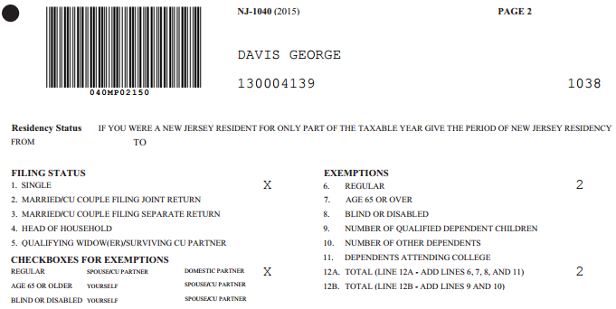
TS - NJ 1040 Page 2 - Domestic Partner
1 regular exemption for taxpayer;
1 for domestic partner

Slide 8
TS - No Extra Exemption For 65 or Over but Addition to Standard Deduction-Federal 1040
TS automatically adds extra to standard
deduction if 65 or older

Slide 9
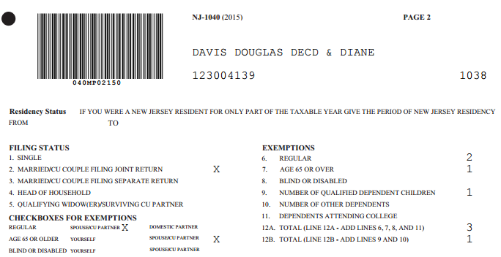
TS - Extra Standard Exemption For 65 or Over - NJ 1040
NJ grants extra personal exemption
if 65 or older

Slide 10
Who is Considered Blind for Federal and State Tax Purposes?
For Federal and State tax purposes a person is considered Blind if on the last day of the year they are totally blind or
A taxpayer who is not totally blind must have a certified statement from an eye doctor (ophthalmologist or optometrist) that:
The taxpayer cannot see better than 20/200 in the better eye with glasses or contact lenses, or
The field of vision is not more than 20 degrees
Additional standard deduction allowed on Federal 1040 for blind
Additional exemption allowed on NJ 1040 for blind

Slide 11
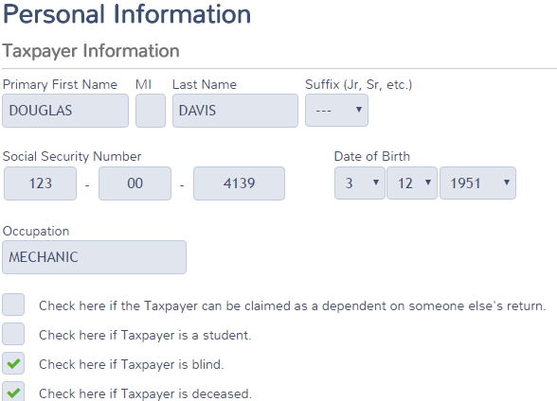
TS - Identification of Blind Basic Information section \ Personal Information

Slide 12
TS - Extra Standard Deduction for Blind Only, Not Disabled – Federal 1040
Federal only grants extra standard deduction
For blind, not disabled
Notes:
No extra standard deduction for disabled on Federal return (only blind)

Slide 13
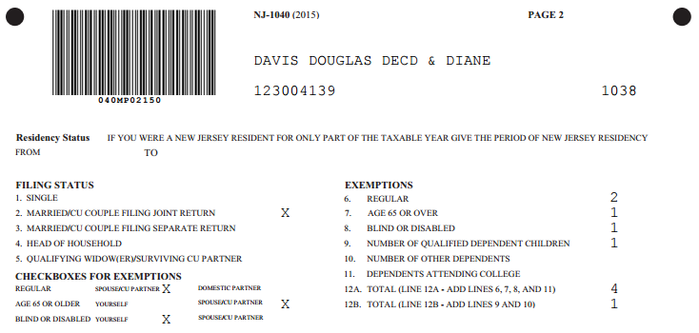
TS - Extra Exemption for Blind – NJ 1040
NJ grants extra exemption for blind OR disabled
Notes:
Can claim extra exemption for blind or disabled on NJ 1040 Line 8
Federal claims 7 exemptions
Taxpayer and spouse
5 children (including grandson)
Also gets extra standard deduction for taxpayer being over 65, but no extra for disabled
NJ claims 11 exemptions
Taxpayer & spouse
Both taxpayer & spouse over 65
Spouse is disabled
5 children (including grandson)
2 full-time college students

Slide 14
Who is Considered Disabled for Federal Tax Purposes?
For Federal tax purposes a person is considered disabled if at any time during the tax year he/she:
Could not engage in substantial gainful activity for pay or profit due to a physical or mental condition AND
A doctor has determined that this condition has lasted or can be expected to last continuously for at least a year or can be expected to lead to death
Additional standard deduction allowed on Federal 1040 for blind only (not other disabilities)
Disabled persons may be eligible for other Federal tax benefits like credits (covered in later modules)
Notes:
Anyone who is receiving SS disability (therefore recorded as disabled) by SS is by default considered disabled

Slide 15
Who is Considered Disabled for NJ Tax Purposes?
For NJ tax purposes: a person is considered disabled if on the last day of the tax year he/she:
Could not engage in substantial gainful activity for pay or profit due to physical or mental impairment, including blindness
Reporting: Must enclose a copy of the doctor’s certificate or other medical records with NJ tax return the first time the exemption is claimed

Slide 16
Who is Considered Disabled for NJ Tax Purposes? (cont’d)
Additional exemption allowed on NJ 1040 for blind or disabled
Only one additional exemption allowed if both blind and disabled
Disabled/Blind persons may be eligible for other NJ tax benefits like property tax relief programs (covered in later module)
Note disabled status on NJ Checklist for later entry in the TaxSlayer State section

Slide 17
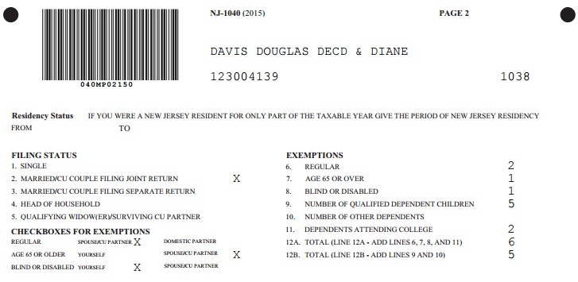
TS - Extra Exemption for Disabled – NJ 1040
Only 1 extra exemption if both blind and disabled
Notes:
Can claim extra exemption for blind or disabled on NJ 1040 Line 8
Federal claims 7 exemptions
Taxpayer and spouse
5 children (including grandson)
Also gets extra standard deduction for taxpayer being over 65, but no extra for disabled
NJ claims 10 exemptions
Taxpayer & spouse
Taxpayer over 65
Spouse is disabled
5 children (including grandson)
2 full-time college students

Slide 18
Federal/State Differences: Exemptions for Minors Who Can Be Claimed on Parent’s Return
ITEM | FEDERAL | STATE | COUNSELOR ACTION
Minor/ Can be claimed on parents’ return (even if not claimed) | Minor cannot claim personal exemption for self | Minor can claim personal exemption for self | Click on Basic Information section \ Personal Information \ “Check here if the Taxpayer can be claimed as a dependent on someone else's return”
Notes:
Note: For Federal return, even if Parent did not claim minor, but could have…student can’t claim self on Federal

Slide 19
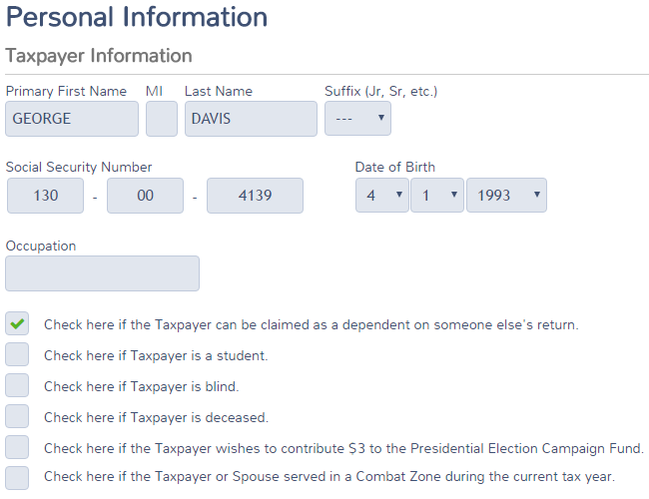
TS - Minor Claimed on Parent’s Return Basic section \ Personal Information (on Minor’s Return)

Slide 20
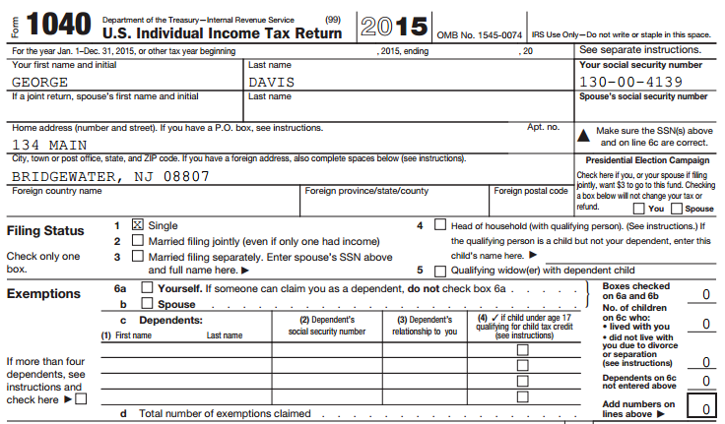
TS - Minor Claimed on Parent’s Return – Minor’s Federal 1040
Can’t take exemption for self since minor was claimed on parents’ Federal return
Notes:
Since minor can be claimed on parents’ Federal return, cannot claim exemption for self on minor’s Federal return

Slide 21
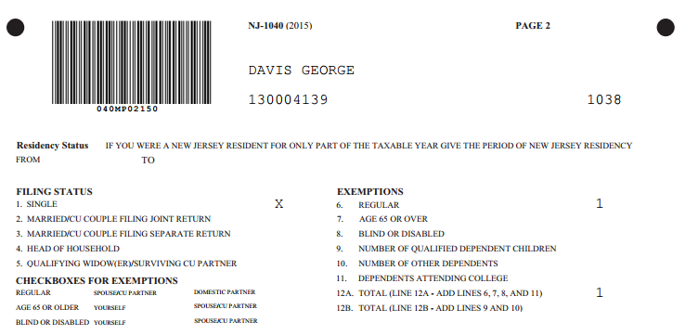
TS - Minor Claimed on Parent’s Return – Minor’s NJ 1040
On NJ 1040, OK to take exemption for self even when minor was claimed on parents’ Federal return
Notes:
Minor can still claim exemption for self on minor’s NJ return, even if parents claimed him
TaxSlayer does this automatically if you check the box that says you can be claimed on someone else’s return
Minor’s return not shown in TaxSlayer

Slide 22
Filing a Return for a Deceased Taxpayer
Pub 4012 Tab K
Deceased taxpayer will be identified as a checked box on Intake/Interview form Page 1, Part II - Widowed
Deceased Taxpayer’s return
Final personal income tax return must be filed
Estate tax return (Form 1041) may need to be filed Out of Scope
Personal tax return can be filed by:
Surviving spouse
Personal representative – Executor of estate or anyone who is in charge of decedent’s property
Court appointed representative
Notes:
22

Slide 23
Filing a Return for a Deceased Taxpayer
Pub 559
(cont’d)
Return filed by surviving spouse
Should include income earned by decedent up to date of death plus full-year income for surviving spouse
TaxSlayer will print “Filing as surviving spouse” as deceased taxpayer signature on Form 8879
Return filed by personal representative (executor or administrator of the decedent’s estate, as appointed or certified by the court)
Only include income & deductions up to date of death
File Form 56 Notice Concerning Fiduciary Relationship to notify IRS of contact for correspondence
Notes:
23

Slide 24
Filing a Return for a Deceased Taxpayer
Pub 559
(cont’d)
If filing a current year tax return and refund is due, attach copy of Court Appointment Certificate
Sign return followed by “Personal Representative”
Return filed by anyone else
If refund is due, include Form 1310 Statement of Person Claiming Refund Due a Deceased Taxpayer
Form 1310 can be found in Federal section \ Miscellaneous Forms
Refer to Pub 4012 Page K-23 for more detail
Notes:
24

Slide 25
TS - Printed 1040 Return Of Deceased Taxpayer
TS populates on printed 1040
Deceased notice will not appear on TS 1040 screen under Summary, only on printed return PDF
Notes:
TS will populate “Deceased” & date of death on name line of printed 1040 page 1
Will not appear on TS 1040 screen
25

